Slide 1
Prediction of C-to-U RNA editing sites in higher plant mitochondria using only nucleotide sequence features
Pufeng Du, Tao He, Yanda Li
Biochemical and Biophysical Research Communications 358 (2007) 336–341
Date: August 15, 2007
Speaker: Chia-Hung Chang

Slide 2
Abstract
RNA editing is a class of post-transcriptional processing which contributes to the organism complexity. C-to-U RNA editing is commonly observed in higher plant mitochondria. The in vivo mechanism of recognizing C-to-U RNA editing sites is still unknown. In recent years, many efforts have been made to computationally predict C-to-U RNA editing sites. But all existing methods require using knowledge other than an RNA sequence. In the present work, we propose the first method for predicting C-to-U RNA editing sites using only nucleotide sequence features.

Slide 3
Abstract (cont’)
This method was developed based on the SVM algorithm combined with a triplet scoring model. Our method can achieve 84% overall accuracy which is comparable to other methods. We also computationally found that several triplets never appear upstream near an edited cytidine, indicating that these triplets may protect a cytidine from being edited. This discovery suggests the need for further experimental research and may be helpful in understanding the editing site recognition mechanism.

Slide 4
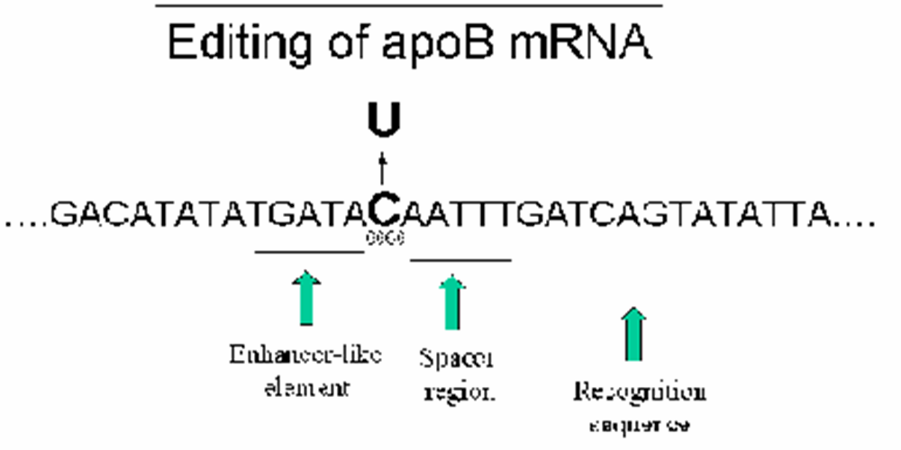
What’s an editing site?

Slide 5
Materials and methods
Data collection.
Feature extraction.
Algorithm design.
Evaluation methods.

Slide 6
Data collection
The dataset is constructed from GenBank and dbRES which is a collection of all types of experimentally validated RNA editing events

Slide 7
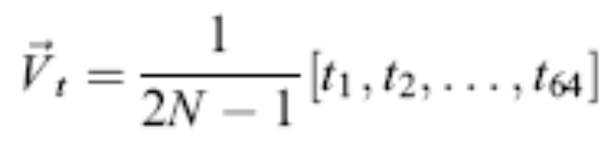
Feature extraction
Triplet composition vector
…cggcgguac…
cgg ggc gcg ggu gua uac
Vector = 1/5 * (2,1,1,1,1,0,0,.....) ,N = 3

Slide 8

Algorithm design
The frequencies of 64 different triplets were estimated
For edited sites
For non-edited sites
The triplet score

Slide 9
Example of scoring model
… | -6 | -5 | -4 | -3 | -2 | -1 | 0 | 1 | 2 | 3 | 4 | 5 | 6 | …
… | u | a | c | g | g | a | c | g | a | c | u | g | c | …
 | edited |  | Non-edited
 | -3 to -1 | 1 to 3 | -3 to -1 | 1 to 3
… | … | … | … | …
gga | 1 | 2 | 3 | 4
gac | 2 | 1 | 1 | 5
… | … | … | … | …

Slide 10
Stri = In ( 1/3 ) + In ( 1/5 )
= -1.0986 + -1.6094
= -2.7062
Whether the output in the first step is positive or not, the result will be negative in this example.

Slide 11
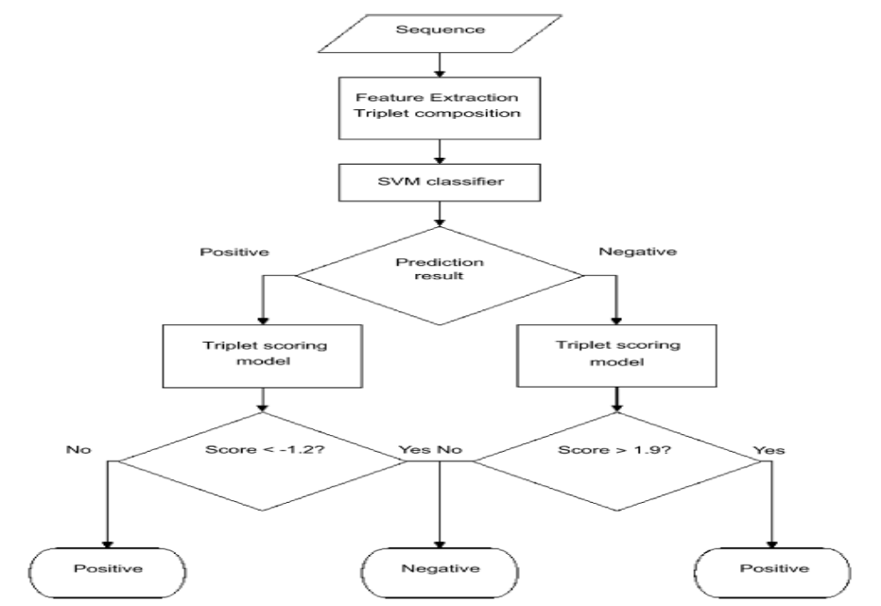

Slide 12
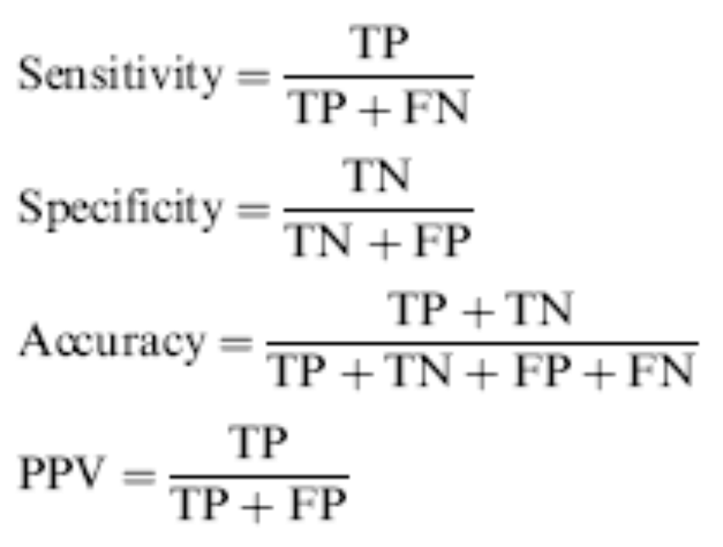
Evaluation methods

Slide 13
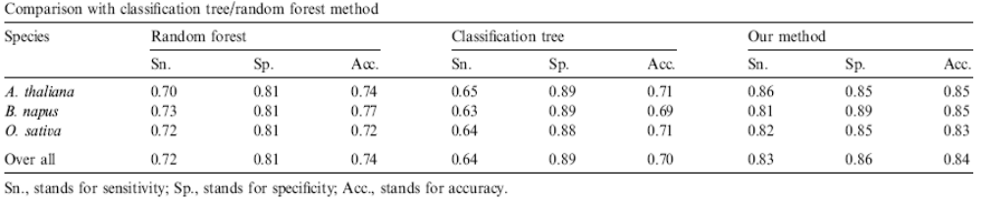
Results

Slide 14
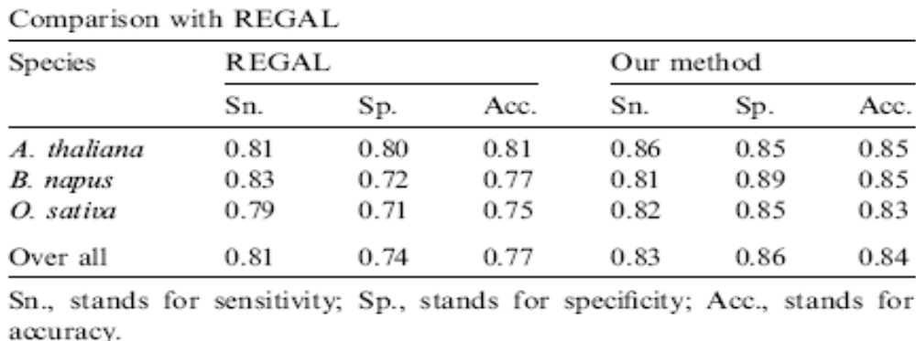
Results (cont’)

Slide 15
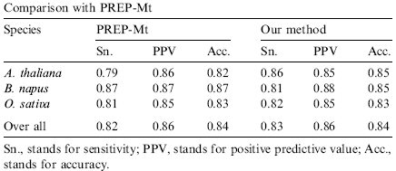
Results (cont’)

Slide 16
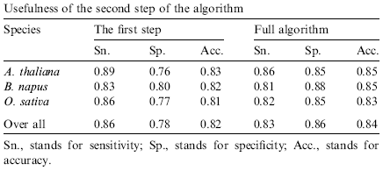
The second step is a fine adjustment

